Slide 1

Topic modeling text Analysis
Zoe Borovsky, PhD
Librarian for Digital Research and Scholarship
zoe@library.ucla.edu

Slide 2
Today’s schedule

Slide 3

What is Topic Modeling?
Topic modeling is a kind of text mining
It allows researchers to analyze a very large corpus to see what “topics” it contains and how those topics are distributed
To use topic modeling, you should
1. Have a large corpus (200 documents)
2. Understand your corpus pretty well
3. Understand how the method of topic modeling works

Slide 4
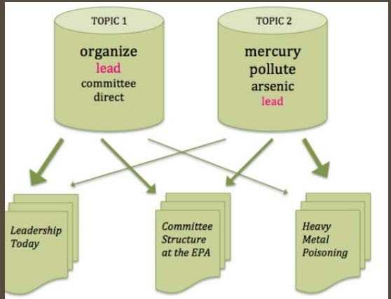
What is Topic Modeling?
Documents are seen as a “bags of words”
“Topics” are collections of words co-occurring in documents across a corpus
Based on results, researchers name topics, or assign meaning to them
Addresses two challenges of machine reading:
1. Words that are spelled the same, different meaning, e.g. lead, beat
2. Words that are spelled differently, mean the same, e.g., African-American, black, colored, etc.

Slide 5
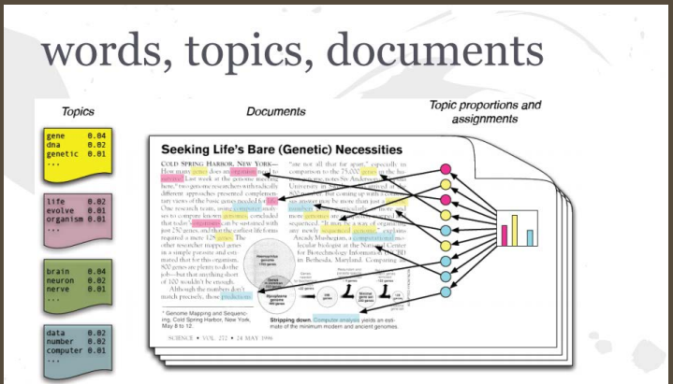
Topics in Documents
Topics = groups of words that tend to occur together in a subset of documents
Words = tokens, strings (characters divided by a space)
Documents = segments of text, turned into a bag of words

Slide 6
What is topic modeling?
Allows us to cluster documents based on topics
A topic model of the entire corpus shows us how topics are distributed

Slide 7
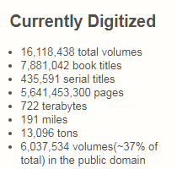
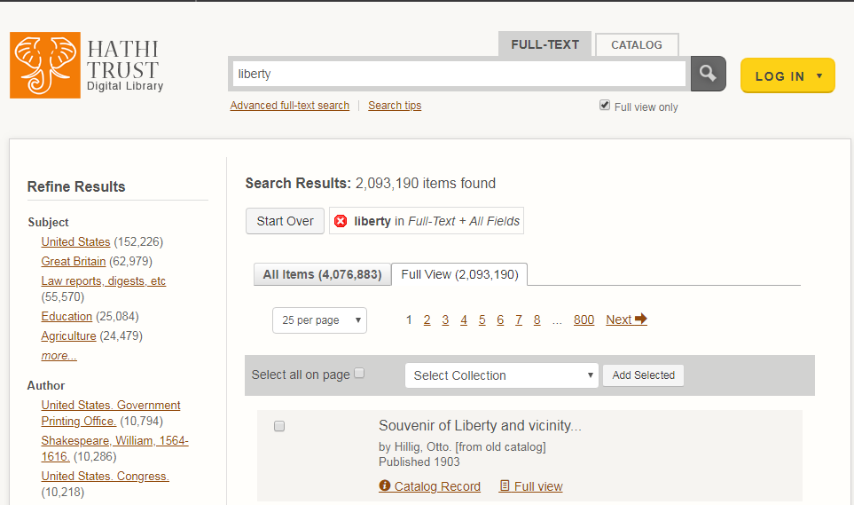
ExampleS
Hathi Trust: entire collection is machine readable and searchable, but keyword searching is not always helpful
What themes are common in 19th century British, Irish, American literature? (Jockers and Mimno, 2012)
3,446 works
500 topics: “female fashion”, “animals and beasts”, “eyes and expressions”, “machine and industry”, etc.
Results: authors wrote about women’s fashion!

Slide 8

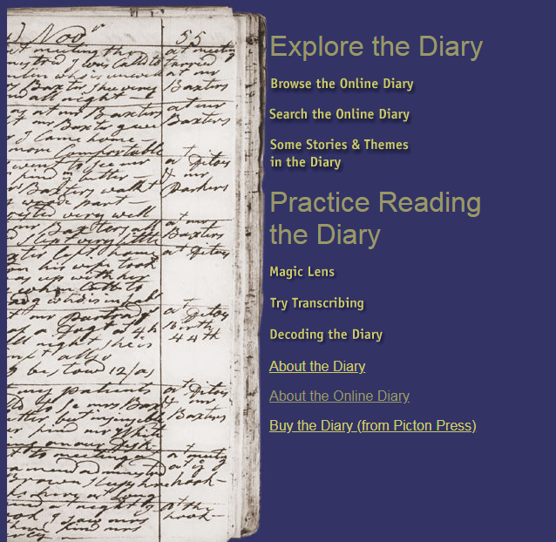
Examples
Martha Ballard’s Diary: 1785
Daily entries for 27 years: transcribed, 1,431 html documents
Details of her life and work as a midwife.
What themes occur over time? (Blevins, 2009)

Slide 9
Libraries and Digital Scholarship
Libraries digitize content
Researchers analyze
Collections as data: opens up new areas of joint work, critical collecting, categorizing
Norwegian Nat’l Library topic-modeled their entire library

Slide 10
Let’s give it a whirl

Slide 11
Libraries and Digital Scholarship
Libraries digitize content
Researchers analyze
Collections as data: opens up new areas of joint work, critical collecting, categorizing
Norwegian Nat’l Library topic-modeled their entire library

Slide 12
Let’s Give it a whirl

